Slide 1
Mind in Motion
Machine Learning for Depression Classification using Motor Actigraphy Data
Baseline Presentation Gary Kong, Julia Kauffman, Leo Le, Vishnu Paty, Melia Soque

Slide 2
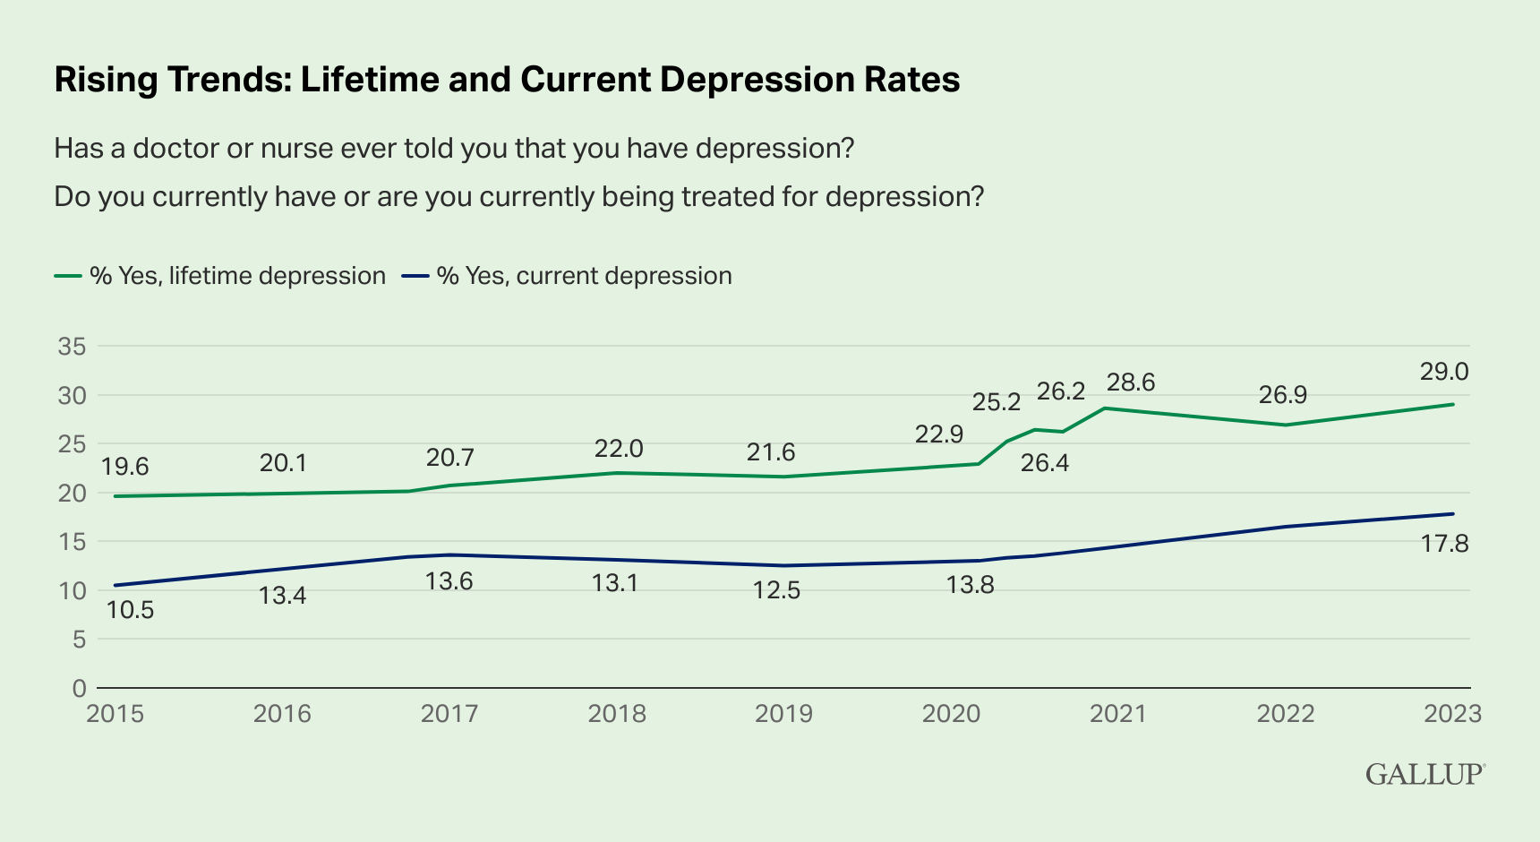
Our study aims to use machine learning to classify patients into depression status using actigraphy data
Depression
Leading cause of disability
Associated with disrupted biological rhythms and changes in motor activity
Subjective diagnosis (DSM-5 criteria)
Motor actigraphy data
Non-invasive
Available through wearables
Potentially objective method of diagnosing depression
Research question
Can machine learning algorithms be used to accurately classify patients into depression status (normal, mild and moderate) using motor actigraphy data?
Sources: Gallup (2023)
Notes:
Hi everyone!
Our focus today is depression, a global concern and a leading cause of disability. Diagnosis usually relies on subjective interpretation of DSM-5 criteria, leading to inconsistent diagnoses. However, advancements in wearable tech now allow for monitoring rest and activity cycles using actigraphy data, which offers an objective way to detect potential indicators of depression. Our main research question is: Can machine learning use motor actigraphy data to accurately identify depression? This could significantly improve early detection and treatment evaluation.

Slide 3
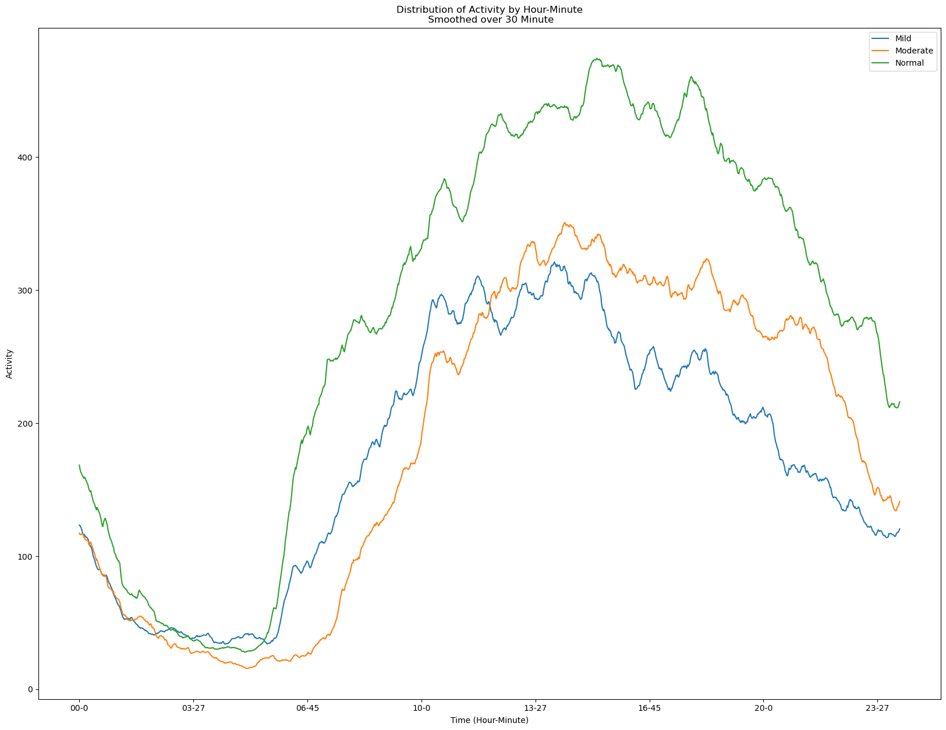
The Depresjon dataset contains actigraph data for controls and patients with mild/moderate depression
Summary Statistics of Depresjon Dataset
Variable | Values | Count | %
MADRS when measurement started (MADRS1) | Normal (<7) | 32 | 58%
 | Mild (7-20) | 7 | 29%
 | Moderate (20-35) | 16 | 13%
MADRS when measurement stopped (MADRS2) | Normal (<7) | 32 | 58%
 | Mild (7-20) | 11 | 22%
 | Moderate (20-35) | 12 | 20%
Gender | Female | 30 | 55%
 | Male | 25 | 45%
Affective Type | Normal | 32 | 58%
 | Unipolar | 15 | 27%
 | Bipolar | 8 | 15%
Days of Observation | Mean | 13 days
Age | Mean | 40 years
Education | Mean | 11 years
Average Daily Activity (30-Minute Rolling Average)
Label
Activity
Time
Notes:
We're using the Depresjon motor actigraphy dataset, collected via an actigraph watch on patients' right wrists, recording activity at one-minute intervals.
The dataset is robust and complete. For each patient, we have timestamped activity measurements. Additional patient details like gender, age, depression type, and MADRS scores for depression classification, alongside social indicators such as education, marital status, and employment.
The left table displays key stats. We grouped patients into three classes: normal, mild, and moderately depressed using a MADRS2 score, which represents depression scores at the end of each patient's observation period. Our sample size is small, with 32 normal, 11 mildly depressed and 12 moderately depressed patients, creating a class imbalance. The majority of our depressed patients are female and unipolar. Each patient has an average of 13 days of data, with an average age of 40 and 11 years of education.
The right chart demonstrates differing activity patterns between normal, mild, and moderately depressed patients. The X axis shows the hour and minute of an average day, the Y axis shows activity levels. Notably, moderately depressed patients start their activity later in the day.

Slide 4
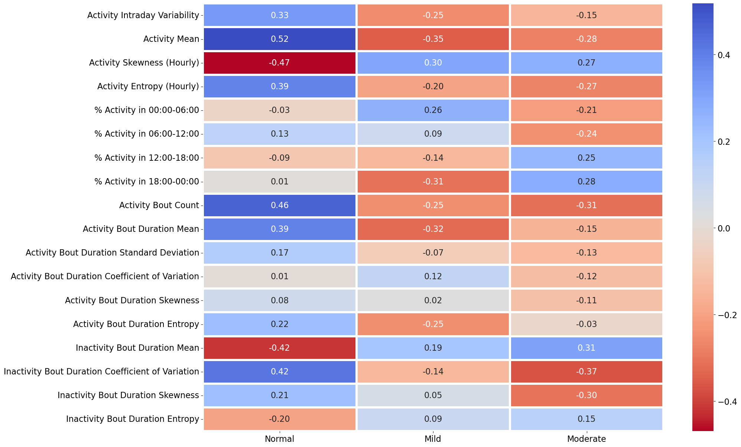
We extracted features that capture differences in activity patterns across depression classes
Correlation of Features with Depression Classes
Statistical metrics capturing distribution of activity
Proportion of activity occurring in different periods of each day
Statistical metrics capturing count and distribution of bouts of activity
Statistical metrics capturing distribution of bouts of inactivity
Notes:
We extracted features from time series motor actigraphy data, inspired by literature on metrics predicting depression status.
Firstly, we looked at statistical metrics. These capture differences in activity distributions between normal patients and those with mild and moderate depression. In this category, we include intraday variability, a measure of daily activity fluctuation. High values here indicate daytime naps or nocturnal activity. We also considered mean activity, activity skewness, and entropy.
Secondly, we analyzed how activity is distributed within days. We did this by adding up activity during specific periods of a day and dividing it by total daily activity. The hypothesis is that patients in the different classes have different proportions of activity occurring at different times of the day.
Our third and fourth categories center on bouts of activity and inactivity. We grouped individual time-series observations into these bouts, calculated the number of bouts, and derived statistics based on their duration. By examining bouts of activity and inactivity, we aim to identify patterns of behavior, such as sedentary behavior or restlessness, that are often associated with depression, thereby enhancing the predictive power of our model.
Finally, please note: we've shown only shortlisted features here. We began with many more candidates, but we excluded those with minimal depression correlation or high intercorrelation.
We are also investigating extracting autoregressive model metrics as features. Incorporating autoregressive model metrics could help capture temporal dependencies and trends in activity data, which may reveal systematic changes in behavior associated with depression.

Slide 5
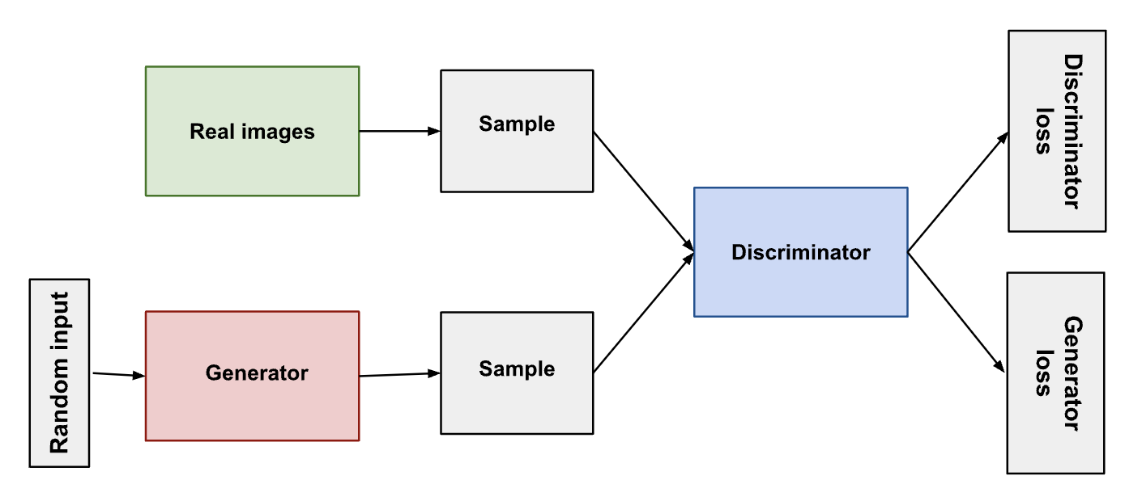
To account for small Ns and address class imbalance, we will use GANs to augment our data
Explored Techniques:
SMOTE (Synthetic Minority Over-sampling Technique)
Cross-Subject Data Fusion
Generative Adversarial Networks (GANs)
Notes:
We have 23 participants in Condition and 32 in Control
Explored options for for class balancing:
1). SMOTE (Synthetic Minority Over-sampling Technique) - creates synthetic samples by interpolating between the feature vectors of neighboring samples
2). Cross-Subject(Domain) Data Fusion - combine activity measurements from different users in time-series and augment with noise
3) Generative Adversarial Networks (GANs) - synthetic data generator that learns underlying distribution of the data and can model new samples that resemble the original data.
GANs:
The generator learns to generate plausible data.
The discriminator learns to distinguish the generator's fake data from real data.

Slide 6
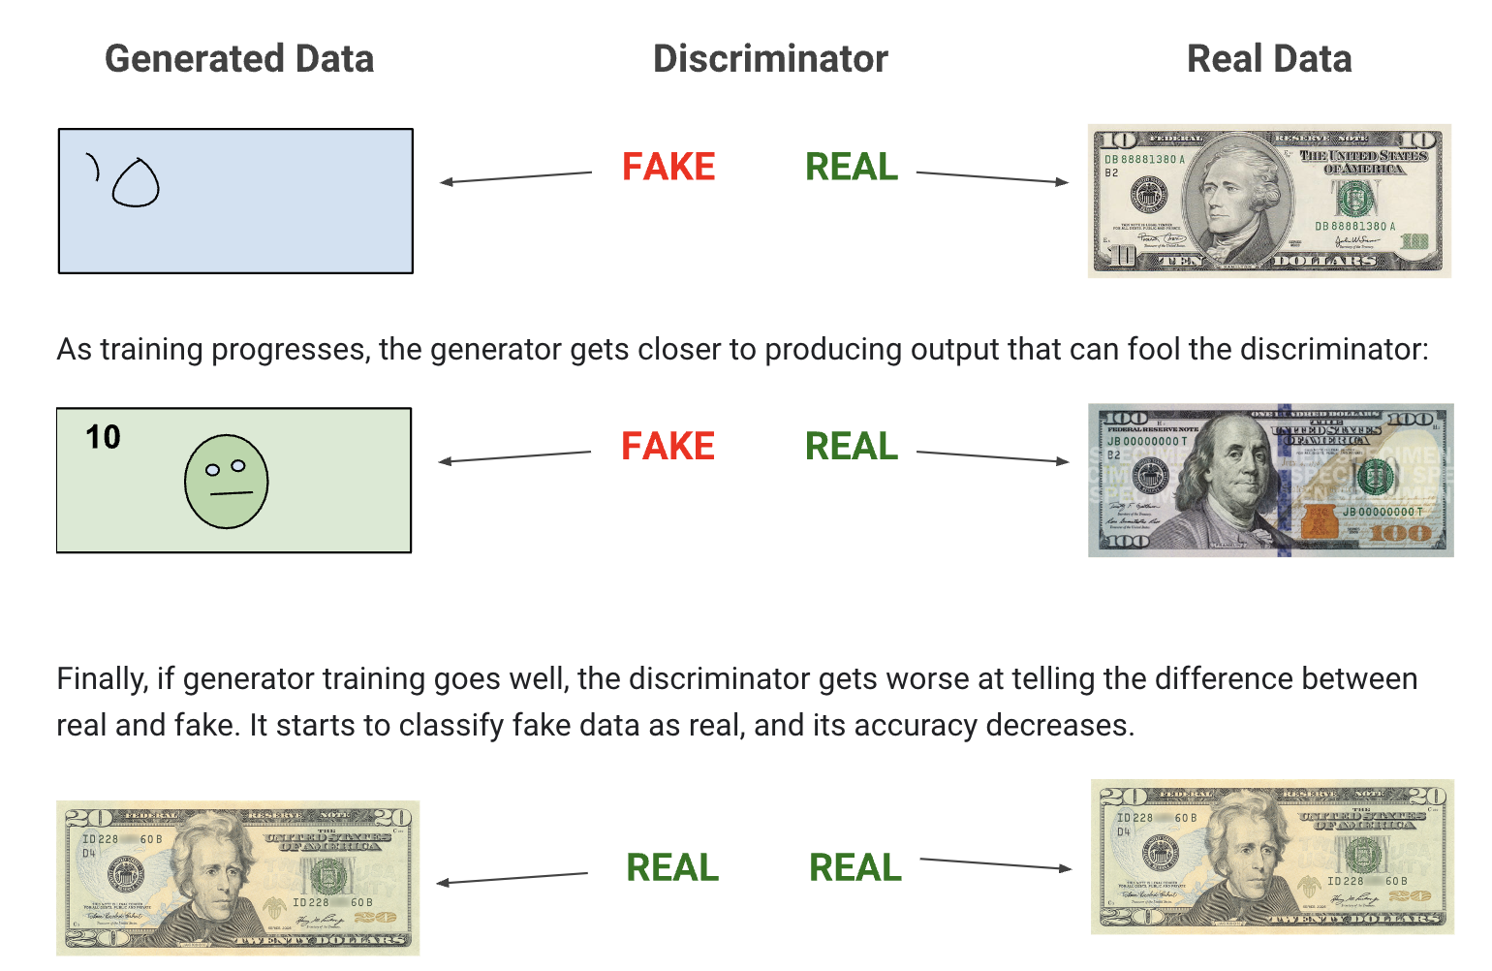
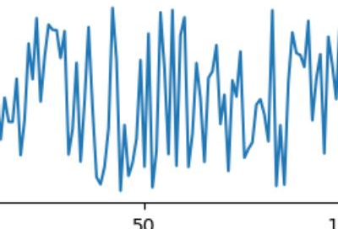
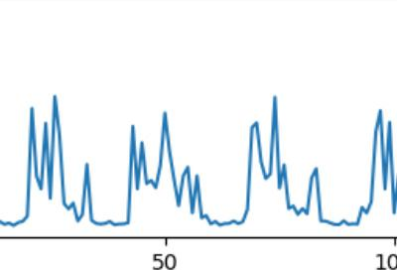
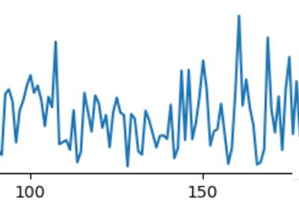
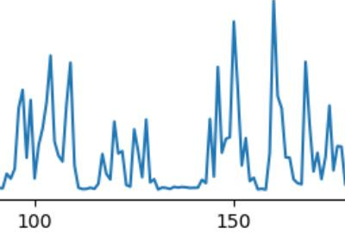
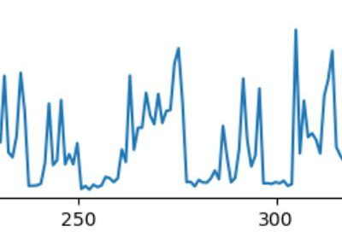
Adversarial training involves a “game of chess” - the generator creates data and discriminator ‘critiques’ it
Notes:
The generator aims to create realistic data, while the discriminator acts as a critic, trying to distinguish between real and generated data. The two opponents engage in an iterative process, each learning and improving from the other's moves.
Wasserstein Loss:
Generator tries to maximize the discriminator's output for its fake instances.
Discriminator tries to maximize the difference between its output on real instances and its output on fake instances
Convergence: Ideally, both losses should stabilize or converge to a certain value, indicating that the generator and discriminator are learning effectively.

Slide 7
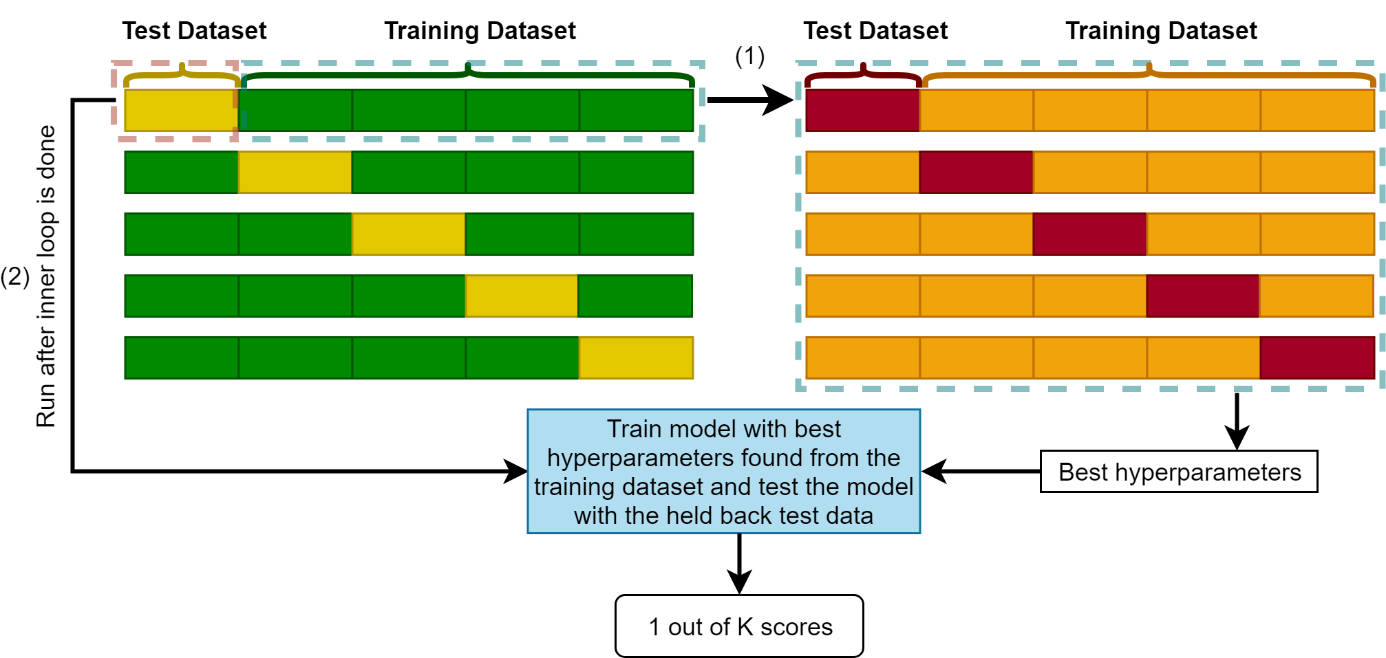
We will use nested cross-validation to validate our model
All outer loops provides a robust estimate of a model's performance
Inner loop prevents information leakage from the test set
K-folds 3, 5, 10
K iterations provides a more reliable estimate of a model's generalization ability
Nested Cross-Validation
OUTER LOOP
INNER LOOP
Notes:
1.We will be implementing two types of cross validation, k-fold cross validation which is effective for performance estimation but may lead to overfitting in the model selection process .nested cross validation addresses this issue especially because we have a smaller dataset.
2.Here it shows the green training data 1)- which takes some parts of the training data to turn it into a test set, colored yellow. That gives an average performance across all outer folds providing a robust estimate of a model's performance.”
3.With nested cross validation, and performing hyperparameter tuning or model selection within the inner loop, we prevent information leakage from the test set to the model selection process, that yields a more unbiased model selection.
In order to find the optimal k-value, I will play around with different k-folds (3,5,10, which are the common folds used in machine learning) and with different splits between the training and test data like 80-20, 90-10, and 70-30.
By doing this it will produce a K score, which is an estimate of the performance and can test the ability of the model to predict new data. This will all be based on the augmented data provided by Claira.

Slide 8
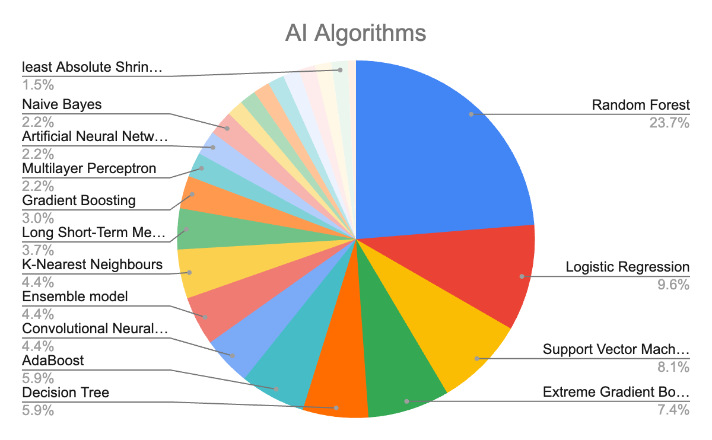
In other studies RF and Logistic Regression are frequently used; accuracy benchmarks are c.70-90%
Evaluation metric | Average top accuracy studies | Average bottom accuracy studies
Accuracy | 89% | 70%
Sensitivity | 87% | 61%
Specificity | 93% | 73%
RMSE | 4.55 | 3.76
Source: Abd-Alrazaq, A., AlSaad, R., Shuweihdi, F., Ahmed, A., Aziz, S., & Sheikh, J. (2023). Systematic Review and meta-analysis of performance of wearable artificial intelligence in detecting and predicting depression. Npj Digital Medicine, 6(1). https://doi.org/10.1038/s41746-023-00828-5
Notes:
We found a systematic review and meta analysis of published research papers from 2015 to 2022 on performance evaluation of wearable device in detecting and predicting depression and this is a good starting point for us to understand what have been done successfully and unsuccessfully. There were a lot of these past research that used the same depressjson data as the basis for their machine learning work. The pie chart on the left represent what type of algorithm do these research used the most. As you can see Random Forest accounts for a quarter of the counts with Logistic Regression comes in second. The table to the right represent the benchmark range of how well these models perform which give us a good base to work with

Slide 9
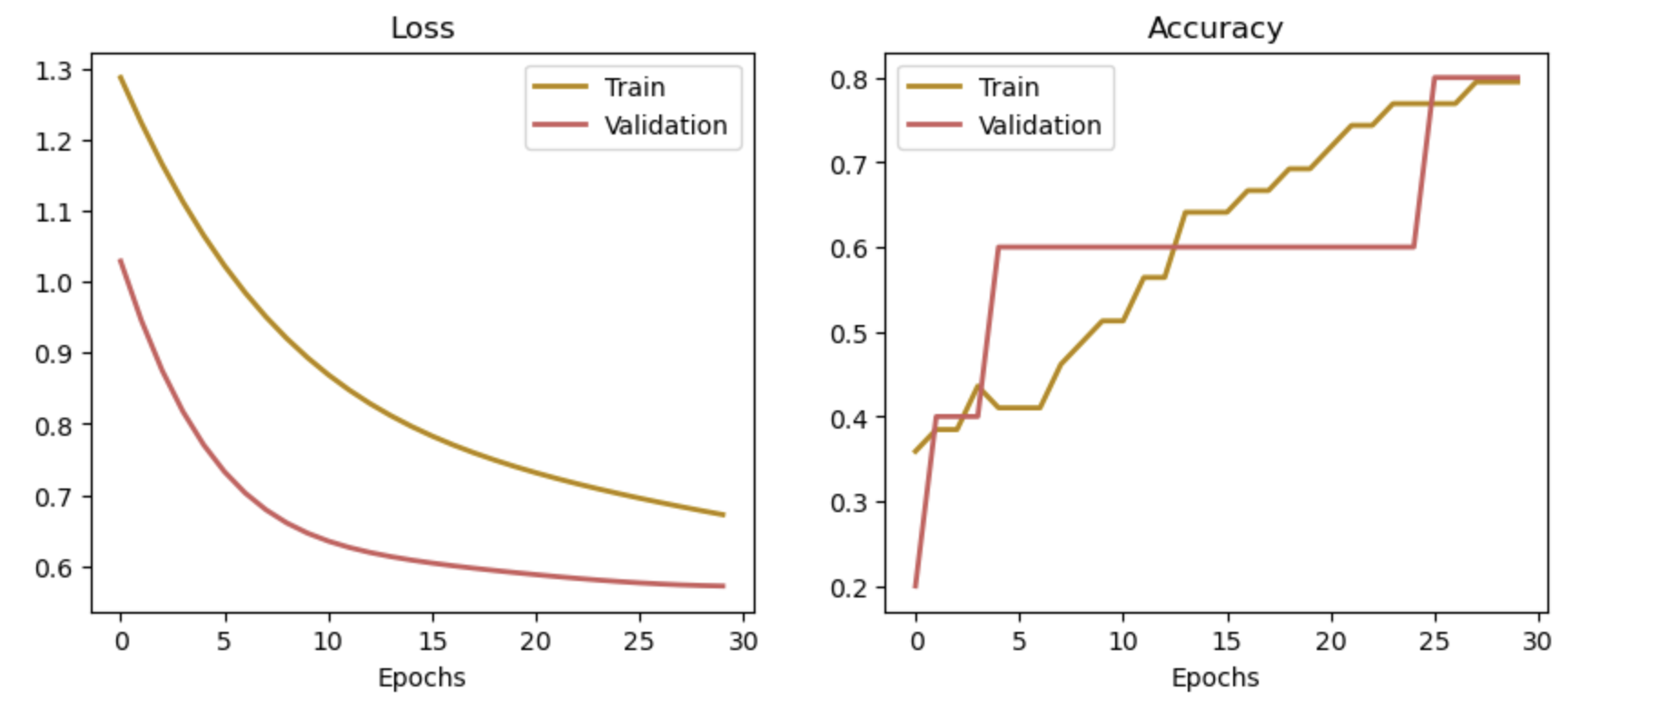
Our baseline model will use logistic regression; we also plan to use random forest and boosted models
Features: Motor Actigraphy Data with 19 features
Implementation: Logistics Regression (3 classes classification)
->Complex model: Random Forest and Boosted Tree Models (Adaboost and XGBoost)
Learning rate : 0.01
Epochs : 30
Batch Size : 64
Validation Split : 0.1
Notes:
This influences our baseline algorithm decision. As Gary mentioned, we will be working with 19 features. The baseline model we chose to implement is logistic regression because it fits with our scope of 3 classes classification. In the complex model, we would like to incorporate Random Forest and Boosted Tree models (Adaboost and XGBoost) because Random Forest was chosen by a lot of the previous research so we’re curious of how that would perform for our features and systemic review paper found out that Boosted Tree Model such as Adaboost yields the average highest accuracy so we would like to test them out as well. The result below is the simple feed of our 54 data points without synthesizing any new data or applying cross validation. To the left is their properties which is pretty simple for right now. Even though we get to the 70-80% accuracy, but the runs were very inconsistent and fluctuates widely due to the small data sizes and limited tuning effort at the current stage.

Slide 10
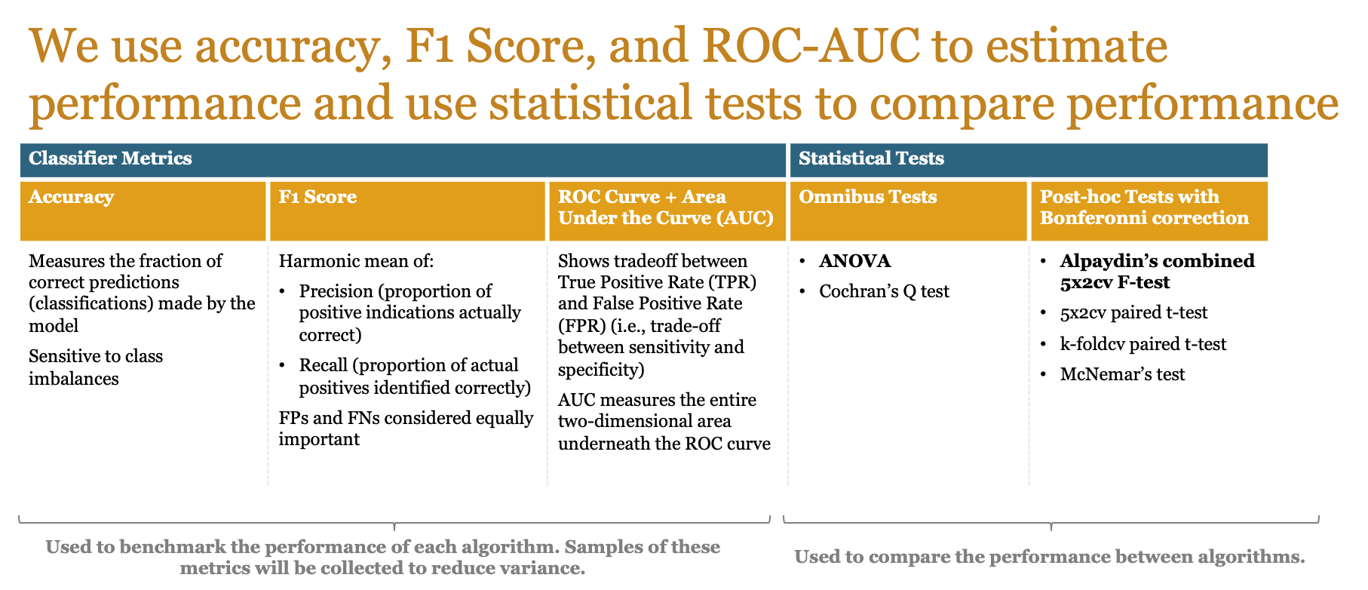
We will use accuracy, F1 score, and ROC-AUC alongside statistical tests to evaluate performance
Source: Raschka, Sebastian. “Model Evaluation, Model Selection, and Algorithm Selection in Machine Learning.” arXiv.Org, 11 Nov. 2020, arxiv.org/abs/1811.12808.
Notes:
We plan to use accuracy, F1 Score, and ROC-AUC to estimate model performance alongside statistical tests for model comparison.
For metrics we decided to use accuracy, and also F1 score, which is a harmonic mean of precision and recall. The important thing to note about the F1 score is that it considers FPs and FNs to be equally important. This aligns with our research goals and thought process that the cost of both types of misclassifications for depression status is roughly equal, which is why we did not consider other F_beta scores that weigh them differently.
Based on similar reasoning, we decided to opt with Area under the ROC curve instead of the precision recall curve.
Next, we plan to use a couple of statistical tests to compare these performance metrics across different models.
When we want to do multiple comparisons (comparing more than two models), we plan to use ANOVA to test whether there is at least one significant difference between different models. We also considered Cochran’s Q test.
These tests are known as omnibus tests which means that they tell us whether there’s a significant difference between Models A, B, and C, but do not tell us if Model A is different from Model B, or if Model C is different from Model B, and so after the omnibus tests we plan to conduct post-hoc pairwise testing for each set of 2 models. Since the omnibus test tells us prior which set of models to run post hoc testing on, we might want to apply a correction procedure like Bonferroni’s correction to prevent a potential “fishing expedition”.
We considered many tests for post-hoc comparisons but ultimately plan to use Alpaydin’s Combined 5x2 Cross Validation F-test based on recommendations from Raschka for small datasets.

